Slide 1
PROJECT PROPOSAL
-Travelling Salesman Problem
(Analysis and implementation
of algorithm)
ROHIT NIKAM
(180001042)
PRADEEP PATIDAR
(180001034)

Slide 2
INDEX
1. Introduction of TSP(Travelling Salesman Problem)
2. List of algorithms discussed
3. Introduction of these algorithms and their analysis

Slide 3
What is travelling salesman problem???

Slide 4
1. INTRODUCTION OF TSP
- Travelling Salesman Problem (TSP): The TSP is a well known computational problem in combinatorial optimization, which is known to be NP­-Complete. Here is an informal definition of the problem: N points (cities), as well as the cost of travelling between every pair of them are given. Assume that a salesperson, starting from a given city, has to visit each city exactly once and hence make a round trip. The aim is to find an optimal tour in which the total cost of the round trip is minimized.
More formally, the TSP can be formulated as a problem in graph theory. Given a complete graph G on a set of V vertices (cities) and a set of E edges, and the cost for each edge, find a Hamiltonian Cycle of minimum total cost.
To complete the definition we shall define the following terms: Complete graph-­ a simple undirected graph in which every pair of distinct vertices is connected by a unique edge.
Therefore, here we will be discussing algorithms which will solve TSP.
We will discuss them in the order of their improving complexities from worst to best (found till now).

Slide 5
2. Algorithms to be discussed
Backtracking
Dynamic programming
Genetic algorithm

Slide 6
Our present work's major aim focuses on highlighting the genetic algorithm's crucial importance and benefits in solving the traveling salesman problem.

Slide 7
First, we will have a look upon non-polynomial time complexity algorithms that inspired us to discover much better algorithms.

Slide 8
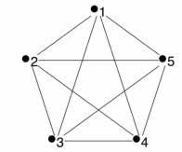
BACKTRACKING
-Key idea used in this algorithm is depth first search in graphs.
-Calculate cost of every traversal from starting city to ending city and keep track of minimum cost and keep on updating the value of minimum cost stored value.
-This implementation will cost
Time complexity- O(n!) Space complexity-O(n^2)

Slide 9
DYNAMIC PROGRAMMING
- Let the given set of vertices be {1, 2, 3, 4,….n}. Let us consider 1 as starting and ending point of output. For every other vertex i (other than 1), we find the minimum cost path with 1 as the starting point, i as the ending point and all vertices appearing exactly once. Let the cost of this path be cost(i), the cost of corresponding Cycle would be cost(i) + dist(i, 1) where dist(i, 1) is the distance from i to 1.
-Now to find cost(i):
define a term C(S, i) be the cost of the minimum cost path visiting each vertex in set S exactly once, starting at 1 and ending at i. We start with all subsets of size 2 and calculate C(S, i) for all subsets where S is the subset, then we calculate C(S, i) for all subsets S of size 3 and so on. Note that 1 must be present in every subset.
-This implementation will cost
Time complexity- O((n^2)*(2^n))
-The time complexity is much less than O(n!), but still exponential.
Space required is also exponential.

Slide 10
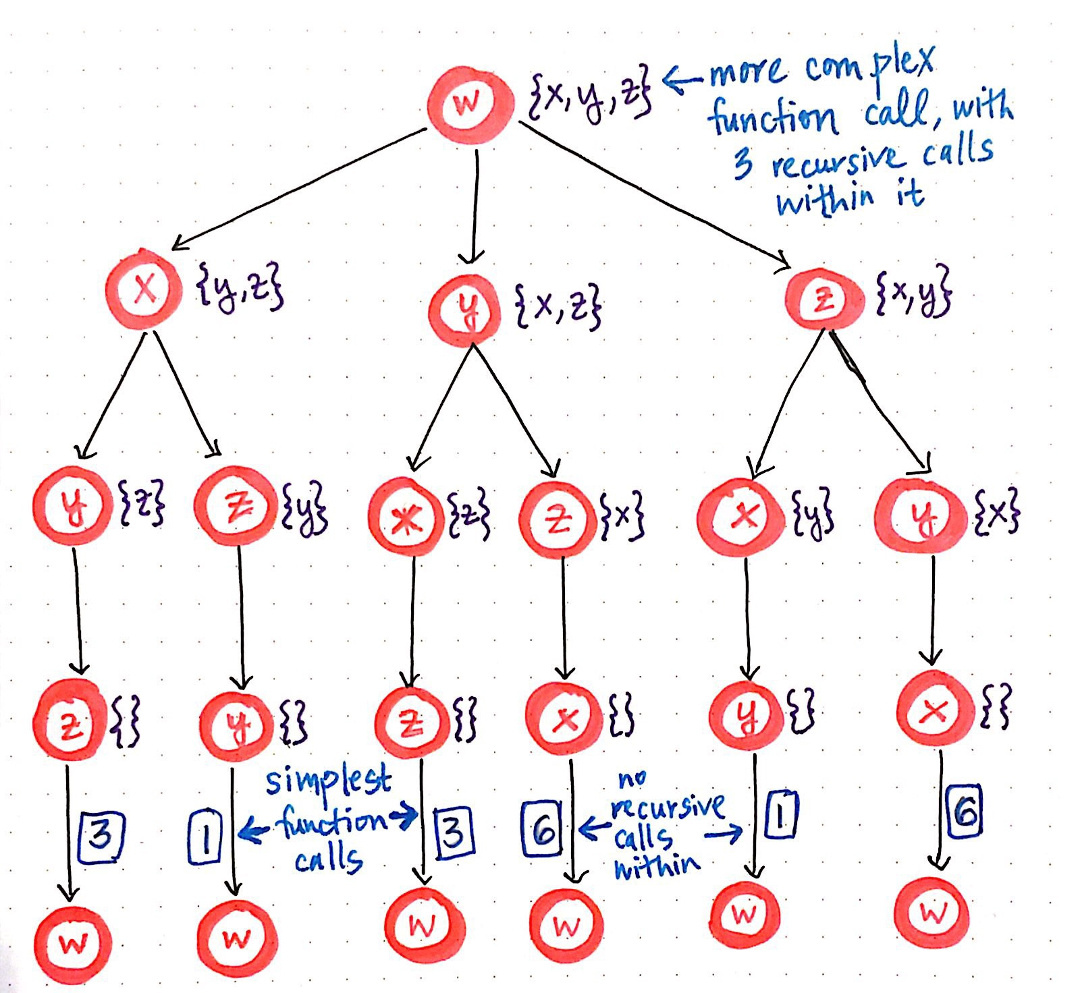
Dynamic programming for TSP.

Slide 11
Here comes our main topic of discussion: Genetic algorithm

Slide 12
GENETIC ALGORITHM
- The genetic algorithm is a famous evolutionary metaheuristic. The genetic algorithm is inspired by biological mechanisms such as Mendel's laws and the theory of evolution proposed by Charles Darwin . His research process solutions to a given problem mimics that living beings in their evolution. It uses the same vocabulary as that of biology and classical genetics, so we talk about: gene, chromosome, individual, population and generation.
The genetic algorithm evolves a population composed of a group of individuals for a whole generation until a stopping criterion is verified. The transition from one population to another is realized through operations of evaluation, selection, reproduction (crossover and mutation) and replacement.
The algorithm starts searching with a set of individuals. Each iteration of the search, the best individuals is selected to survive and reproduce. The selection of individuals is based on their qualities are measured from a feature called “objective function or fitness function.” Then individuals (called parents) are selected to undergo crossover and mutation operators to the generation of another population of individuals (called children). The individuals of the new population will be assessed to replace some individuals of the current population
- This implementation will cost
Time complexity- O(l*m*n)
(l=no. of cities, m=population, n=no. of iterations/generations) -Space complexity-O(l^2)

Slide 13
Two main features of genetic algorithm: 1. Genetic mutation 2. Genetic crossover

Slide 14
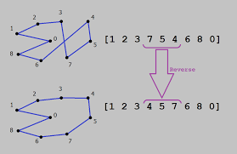
Genetic mutation

Slide 15
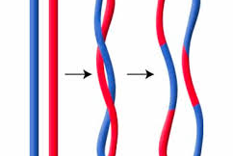
Genetic crossover

Slide 16
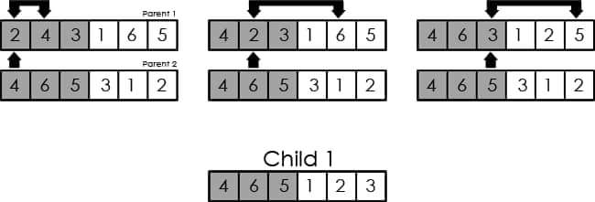
Genetic crossover

Slide 17
Code: https://github.com/rohitnikam16/AlgorithmAnalysis/blob/master/genetic%20algorithm%20tsp.cpp Output: https://raw.githubusercontent.com/rohitnikam16/AlgorithmAnalysis/master/output%20for%20genetic%20algorithm.jpg

Slide 18
History or background of genetic algorithm
Genetic Algorithms (GAs) were developed by Prof. JohnHolland and his students at the University of Michigan during the 1960s and 1970s. Essentially, they are a method of "breeding" computer programs and solutions to optimization or search problems by means of simulated evolution. Processes loosely based on natural selection, crossover, and mutation are repeatedly applied to a population of binary strings which represent potential solutions. Over time, the number of above-average individuals increases, and highly-fit building blocks are combined from several fit individuals to find good solutions to the problem at hand.

Slide 19
Conclusion
A Genetic Algorithm is a population based search and Optimization method that mimics the process of natural evolution. The functioning of Genetic Algorithm is inspired by two main concepts of natural evolution – natural selection and genetics dynamics involving different genetic operations like crossover, mutation etc.
The prime motto of the selection operator is to identify the better solutions in a population and include them to participate to form next generation.
And yes we were successful in finding optimal path in our travelling salesman problem.(Actual solution=21, Algorithm solution=21)

Slide 20
References
1.Greedy Permuting Method for Genetic Algorithm on Traveling Salesman Problem Junjun Liu and Wenzheng u ' College ofComputer Science and Technology, Faculty ofInformation Technology Beijing University ofTechnology No. 100, Pingleyuan, Chaoyang District, Beijing 100124, China liujunjun@ l26.com
2.Traveling Salesman Problem of Optimization based on Genetic Algorithms Walid Ellili, Mounir Samet, Abdennaceur Kachouri University of Sfax, LETI, ENIS Sfax, Tunisia elliliwalid@gmail.com, mounir.samet@enis.rnu.tn, abdennaceur.kachouri@enis.rnu.tn
[1] Bellmore M, Nemhauser GL. The traveling salesman problem: a survey. Oper Res 1968;16:538–58 [2] Chatterjee S, Carrera C, Lynch LA. Genetic algorithms and traveling salesman problems.Eur J Oper Res 1996;93(3):490–510.
[3] R.E. Bellman, Dynamic programming treatment of the traveling salesman problem, Journal of the ACM 9 (1962) 61–63.
[4] M. Bellmore, G.L. Nemhauser, The traveling salesman problem: a survey, Operations Research 16 (1968) 538–558.
[5] D.E. Goldberg, Messy genetic algorithms: motivation, analysis, and first results, Complex Systems 3 (1989) 493–530.
[6] L. Huang, C.G. Zhou, K.P. Wang, Hybrid ant colony algorithm for traveling salesman problem, Progress in Natural Science 4 (13) (2003) 295–299.
[7] Rego.C and C. Roucairol. Le problème de tournées de véhicules : Etude et Résolution Approchée. Technical Report. INRIA, Février 1994.
[8] S. Bourazza. Variantes d'algorithmes génétiques appliquées aux problèmes d'ordonnancement. Thèse de doctorat. Université du Havre, France. 2006.
[9] C. Darwin. The origin of species by means of natural selection. Mentor Reprint, New York, 1859.
[10] http://www.orientation.tn/orient/liens/distance.htm

Slide 21
[I] Holland, John H., Adaptation in Neural and Artificial Systems. University of Michigan Press, 1975. 50 [2] Darwin, Charles, and William F. Bynum. The origin ofspecies by means of natural selection: or, the preservation of favored races in the struggle for life. Penguin, 2009 . [3] Potvin, Jean Yves. "Genetic algorithms for the traveling salesman problem," Annals of Ope rations Resea rch, vol. 63, no. 3, pp. 337 -370, 1996. [4] Sigl, B., M. Golub, and V. Mornar. "Solving time table scheduling problem using gene tic algorithms," Proceedings of the International Confere nce on Information Techno logy Interfaces (lTI), pp. 519-524, 2003 . [5] Hong, Tzung Pei, et al. "Evolution of Appropriate Crossover and Mutation Operators in a Genetic Process," Applied Intelligence, vol. 16, no. I, pp. 7- 17,2002. [6] Deng, Yong, Y. Liu, and D. Zhou. "An Improved Gene tic Algorithm with Initial Population Strategy for Symmetric TSP," Mathematical Problems in Engineering, vol. 20 15, no. 3, pp. 1-6, 2015. [7] Luo, C. Y., B. Lu, and F. Liu. "Neighbo ur field method for population initialization ofTSP," Journ al ofChongq ing Unive rsity, vol. 32, no. 11, pp. 1311- 1315,2009. 51 [8] lsrnkhan, Hassan, and K. Zamanifar. "Developing Improved Greedy Crossover to Solve Symme tric Trave ling Salesman Problem," International Journal of Computer Science Issues, vol. 9, no. 4, pp. 121- 126, 2012. [9] Hassanat, Ahmad B. A, and E. Alkafaween. "On Enhancing Gene tic Algorithms Using New Crossovers." International Journal of Com puter Applications in Tec hnology, vol. 55, no. 3, pp: 202-212,2017. [10] Raza li, Noraini Mohd, and John Geraghty. "Genetic algorithm performance with different selection strategies in solving TSP," Proce edings of the World Congress on Engineering 20 11 (WCE 20 11), 20 11, vol. 2, pp. 1134-11 39. [11] Serpell, Ma rtin, and James E. Smith. "Self-adaptation of mutation ope rator and proba bility for permutation represen tations in genetic algorithms," Evolutionary Computation, vol. 18, no . 3, pp. 49 1-5 14, 2010 . [12] Gerhard Reinelt, TSPLlB, [Onl ine] Av

Slide 22
Acknowledgement
We are thankful to our professor Dr. Kapil Ahuja for giving us such wonderful project from which we learned a lot and got wide information.

